Slide 1
Mathematical Foundations for Data Science
MFDS Team

Slide 2
DSECL ZC416, MFDS
Lecture No. 13

Slide 3
Agenda
The Basics of Counting
The Pigeonhole Principle
The Generalized Pigeonhole Principle
Permutations
Combinations

Slide 4
Basic Counting Principles: The Product Rule
The Product Rule: A procedure can be broken down into a sequence of two tasks. There are n₁ ways to do the first task and n₂ ways to do the second task. Then there are n₁∙n₂ ways to do the procedure.
Example: How many bit strings of length seven are there?
Solution: Since each of the seven bits is either a 0 or a 1, the answer is 2⁷ = 128.

Slide 5
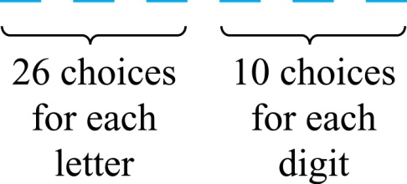
The Product Rule
Example: How many different license plates can be made if each plate contains a sequence of three uppercase English letters followed by three digits?
Solution: By the product rule,
there are 26 ∙ 26 ∙ 26 ∙ 10 ∙ 10 ∙ 10 = 17,576,000 different possible license plates.

Slide 6
Counting Functions
Counting Functions: How many functions are there from a set with m elements to a set with n elements?
Solution: Since a function represents a choice of one of the n elements of the codomain for each of the m elements in the domain, the product rule tells us that there are n ∙ n ∙ ∙ ∙ n = n^{m} such functions.

Slide 7
Counting Functions
Counting One-to-One Functions: How many one-to-one functions are there from a set with m elements to one with n elements?
Solution: Suppose the elements in the domain are a₁, a₂,…, a_{m}. There are n ways to choose the value of a₁ and n−1 ways to choose a₂, etc. The product rule tells us that there are n(n−1) (n−2)∙∙∙(n−m +1) such functions.

Slide 8
Product Rule in Terms of Sets
If A₁, A₂, … , A_{m} are finite sets, then the number of elements in the Cartesian product of these sets is the product of the number of elements of each set.
The task of choosing an element in the Cartesian product A₁ ⨉ A₂ ⨉ ∙∙∙ ⨉ A_{m} is done by choosing an element in A₁, an element in A₂ , …, and an element in A_{m}.
By the product rule, it follows that:
|A₁ ⨉ A₂ ⨉ ∙∙∙ ⨉ A_{m} |= |A₁| ∙ |A₂| ∙ ∙∙∙ ∙ |A_{m}|.

Slide 9
Basic Counting Principles: The Sum Rule
The Sum Rule: If a task can be done either in one of n₁ ways or in one of n₂, where none of the set of n₁ ways is the same as any of the n₂ ways, then there are n₁ + n₂ ways to do the task.
Example: The mathematics department must choose either a student or a faculty member as a representative for a university committee. How many choices are there for this representative if there are 37 members of the mathematics faculty and 83 mathematics majors and no one is both a faculty member and a student.
Solution: By the sum rule it follows that there are 37 + 83 = 120 possible ways to pick a representative.
The sum rule can be phrased in terms of sets. |A ∪ B|= |A| + |B| as long as A and B are disjoint sets.
Or more generally, |A₁ ∪ A₂ ∪ ∙∙∙ ∪ A_{m} |= |A₁| + |A₂| + ∙∙∙ + |A_{m}|
when A_{i} ∩ A_{j} = ∅ for all i, j.

Slide 10
Combining the Sum and Product Rule
Example: Suppose statement labels in a programming language can be either a single letter or a letter followed by a digit. Find the number of possible labels.
Solution: Use the product rule.
26 + 26 ∙ 10 = 286

Slide 11
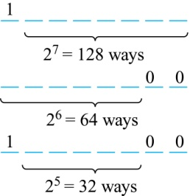
Basic Counting Principles: Subtraction Rule
Subtraction Rule: If a task can be done either in one of n₁ ways or in one of n₂ ways, then the total number of ways to do the task is n₁ + n₂ minus the number of ways to do the task that are common to the two different ways. Also known as, the principle of inclusion-exclusion:
Example: How many bit strings of length eight either start with a 1 bit or end with the two bits 00?
Solution: Use the subtraction rule.
Number of bit strings of length eight that start with a 1 bit: 2⁷ = 128
Number of bit strings of length eight that end with bits 00: 2⁶ = 64
Number of bit strings of length eight that start with a 1 bit and end with bits 00 : 2⁵ = 32
Hence, the number is 128 + 64 − 32 = 160.

Slide 12
Basic Counting Principles: Division Rule
Division Rule: There are n/d ways to do a task if it can be done using a procedure that can be carried out in n ways, and for every way w, exactly d of the n ways correspond to way w.
Restated in terms of sets: If the finite set A is the union of n pairwise disjoint subsets each with d elements, then n = |A|/d.
In terms of functions: If f is a function from A to B, where both are finite sets, and for every value y ∈ B there are exactly d values x ∈ A such that f(x) = y, then |B| = |A|/d.

Slide 13
Basic Counting Principles: Division Rule
Example: How many ways are there to seat four people around a circular table, where two seatings are considered the same when each person has the same left and right neighbor?
Solution: Number the seats around the table from 1 to 4 proceeding clockwise. There are four ways to select the person for seat 1, 3 for seat 2, 2, for seat 3, and one way for seat 4.
Thus there are 4! = 24 ways to order the four people. But since two seatings are the same when each person has the same left and right neighbor, for every choice for seat 1, we get the same seating.
Therefore, by the division rule, there are 24/4 = 6 different seating arrangements.

Slide 14
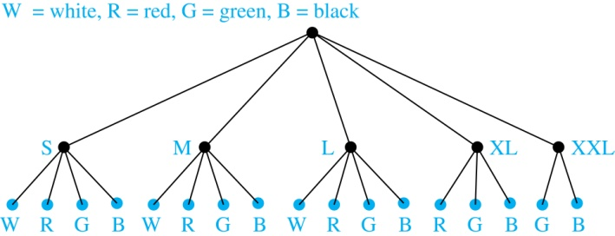
Tree Diagrams
Tree Diagrams: We can solve many counting problems through the use of tree diagrams, where a branch represents a possible choice and the leaves represent possible outcomes.
Example: Suppose that “I Love Discrete Math” T-shirts come in five different sizes: S,M,L,XL, and XXL. Each size comes in four colors (white, red, green, and black), except XL, which comes only in red, green, and black, and XXL, which comes only in green and black. What is the minimum number of shirts that the campus book store needs to stock to have one of each size and color available?
Solution: Draw the tree diagram.
The store must stock 17 T-shirts.

Slide 15
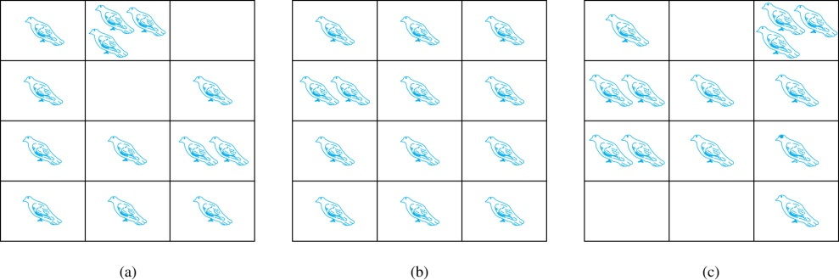
The Pigeonhole Principle
If a flock of 20 pigeons roosts in a set of 19 pigeonholes, one of the pigeonholes must have more than 1 pigeon.
Pigeonhole Principle: If k is a positive integer and k + 1 objects are placed into k boxes, then at least one box contains two or more objects.
Proof: We use a proof by contraposition. Suppose none of the k boxes has more than one object. Then the total number of objects would be at most k. This contradicts the statement that we have k + 1 objects.

Slide 16
The Pigeonhole Principle
Corollary 1: A function f from a set with k + 1 elements to a set with k elements is not one-to-one.
Proof: Use the pigeonhole principle.
Create a box for each element y in the codomain of f .
Put in the box for y all of the elements x from the domain such that f(x) = y.
Because there are k + 1 elements and only k boxes, at least one box has two or more elements.
Hence, f can’t be one-to-one.

Slide 17
Pigeonhole Principle
Example: Among any group of 367 people, there must be at least two with the same birthday, because there are only 366 possible birthdays.

Slide 18
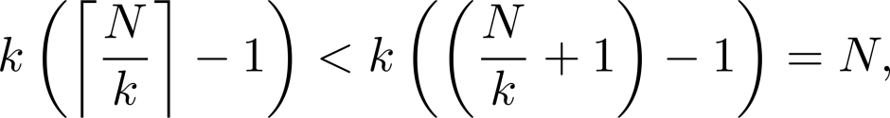
The Generalized Pigeonhole Principle
The Generalized Pigeonhole Principle: If N objects are placed into k boxes, then there is at least one box containing at least ⌈N/k⌉ objects.
Proof: We use a proof by contraposition. Suppose that none of the boxes contains more than ⌈N/k⌉ − 1 objects. Then the total number of objects is at most
where the inequality ⌈N/k⌉ < ⌈N/k⌉ + 1 has been used. This is a contradiction because there are a total of n objects.
Example: Among 100 people there are at least ⌈100/12⌉ = 9 who were born in the same month.

Slide 19
The Generalized Pigeonhole Principle
Example:
1) How many cards must be selected from a standard deck of 52 cards to guarantee that at least three cards of the same suit are chosen?
Answer
We assume four boxes; one for each suit. Using the generalized pigeonhole principle, at least one box contains at least ⌈N/4⌉ cards. At least three cards of one suit are selected if ⌈N/4⌉ ≥3. The smallest integer N such that ⌈N/4⌉ ≥3 is N = 2 ∙ 4 + 1 = 9.

Slide 20
The Generalized Pigeonhole Principle
2) How many must be selected to guarantee that at least three hearts are selected?
Answer
A deck contains 13 hearts and 39 cards which are not hearts. So, if we select 41 cards, we may have 39 cards which are not hearts along with 2 hearts. However, when we select 42 cards, we must have at least three hearts. (Note that the generalized pigeonhole principle is not used here.)

Slide 21
Permutations
Definition: A permutation of a set of distinct objects is an ordered arrangement of these objects. An ordered arrangement of r elements of a set is called an r-permutation.
Example: Let S = {1,2,3}.
The ordered arrangement 3,1,2 is a permutation of S.
The ordered arrangement 3,2 is a 2-permutation of S.
The number of r-permuatations of a set with n elements is denoted by P(n,r).
The 2-permutations of S = {1,2,3} are 1,2; 1,3; 2,1; 2,3; 3,1; and 3,2. Hence, P(3,2) = 6.

Slide 22
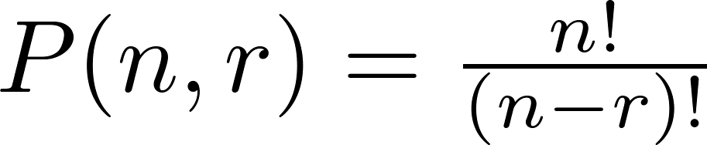
A Formula for the Number of Permutations
Theorem 1: If n is a positive integer and r is an integer with 1 ≤ r ≤ n, then there are
P(n, r) = n(n − 1)(n − 2) ∙∙∙ (n − r + 1) r-permutations of a set with n distinct elements.
Proof: Use the product rule. The first element can be chosen in n ways. The second in n − 1 ways, and so on until there are (n − ( r − 1)) ways to choose the last element.
Corollary 1: If n and r are integers with 1 ≤ r ≤ n, then

Slide 23
Solving Counting Problems by Counting Permutations
Example: How many ways are there to select a first-prize winner, a second prize winner, and a third-prize winner from 100 different people who have entered a contest?
Solution: P(100,3) = 100 ∙ 99 ∙ 98 = 970,200
Example: How many permutations of the letters ABCDEFGH contain the string ABC ?
Solution: We solve this problem by counting the permutations of six objects, ABC, D, E, F, G, and H.
6! = 6 ∙ 5 ∙ 4 ∙ 3 ∙ 2 ∙ 1 = 720

Slide 24
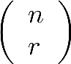
Combinations
Definition: An r-combination of elements of a set is an unordered selection of r elements from the set. Thus, an r-combination is simply a subset of the set with r elements.
The number of r-combinations of a set with n distinct elements is denoted by C(n, r). The notation is also used and is called a binomial coefficient.
Example: Let S be the set {a, b, c, d}. Then {a, c, d} is a 3-combination from S. It is the same as {d, c, a} since the order listed does not matter.
C(4,2) = 6 because the 2-combinations of {a, b, c, d} are the six subsets {a, b}, {a, c}, {a, d}, {b, c}, {b, d}, and {c, d}.

Slide 25
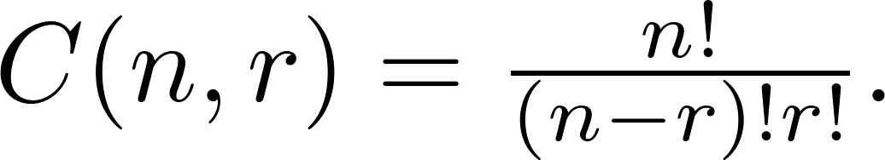
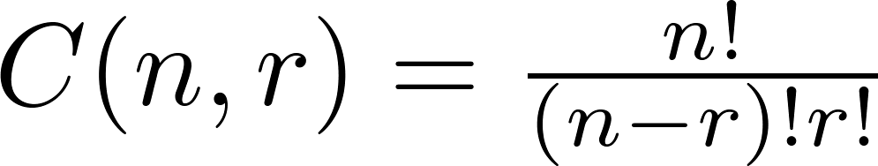
Theorem 2 : Combinations
Theorem 2: The number of r-combinations of a set with n elements, where n ≥ r ≥ 0, equals
Proof: By the product rule P(n, r) = C(n,r) ∙ P(r,r). Therefore,
Corollary 2: Let n and r be nonnegative integers with r ≤ n. Then C(n, r) = C(n, n − r).
Proof: From Theorem 2, it follows that
and
Hence, C(n, r) = C(n, n − r).

Slide 26
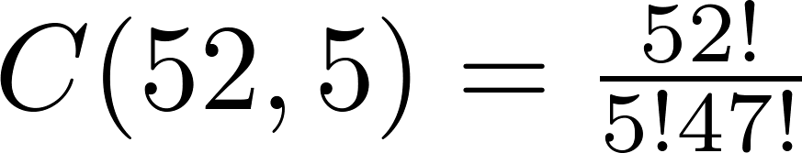
Combinations
Example: How many poker hands of five cards can be dealt from a standard deck of 52 cards? Also, how many ways are there to select 47 cards from a deck of 52 cards?
Solution: Since the order in which the cards are dealt does not matter, the number of five card hands is:
The different ways to select 47 cards from 52 is

